Slide 1
JUST ENOUGH ADMINISTRATION
Introduction

Slide 2


Hello!
I Am Victor Silva
Twitter: @vmsilvamolina
Blog: https://blog.victorsilva.com.uy

Slide 3

JUST ENOUGH ADMINISTRATION?

Slide 4
“
Just Enough Administration (JEA) is a PowerShell security technology that provides a role based access control platform for anything that can be managed with PowerShell.
“

Slide 5
Reduce the number of administrators on your machines
Limit what users can do
Better understand what your users are doing

Slide 6
INSTALL
Server Operating System | JEA Availability
Windows Server 2016 | Preinstalled
Windows Server 2012 R2 | Full functionality with WMF 5.1
Windows Server 2012 | Full functionality with WMF 5.1
Windows Server 2008 R2 | Reduced functionality with WMF 5.1
Notes:
JEA viene con PowerShell 5.0 o superior (Windows Management Framework)

Slide 7
DETERMINE WHICH COMMANDS TO ALLOW
Identify the commands
Update use of PowerShell
Restrict the scope
Create custom functions
Test :)

Slide 8
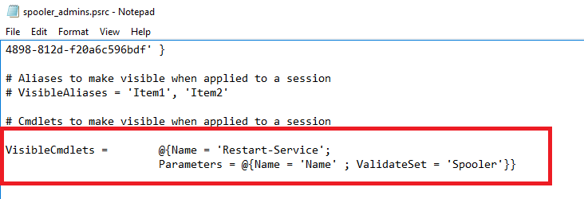
DEFINE LIMITS

Slide 9
INTEGRATION
PowerShell DSC (Desire State Configuration)

Slide 10
HOW TO WORK?
PowerShell Remoting provides the foundation on which JEA is built.
Conclusion: Run Enable-PSRemoting
Optional: Enable PowerShell module and script block logging
Notes:
Opcional para registrar todas las ejecuciones de forma centralizada
You can configure the PowerShell Module Logging policy using Group Policy

Slide 11
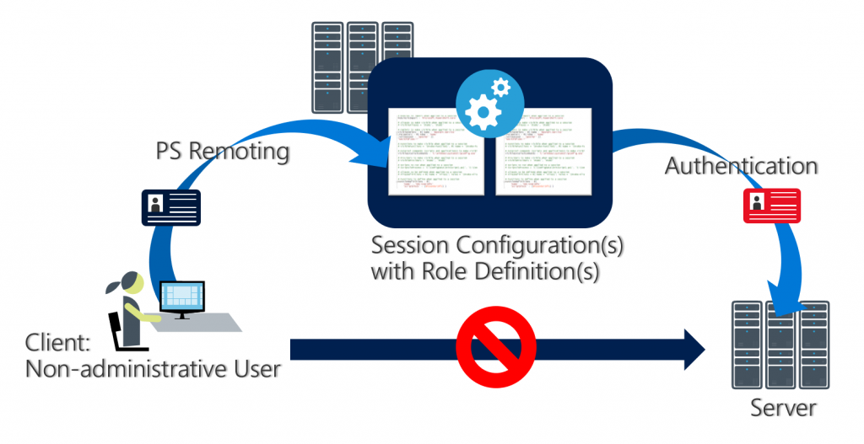
HOW TO WORK?
Notes:
Opcional para registrar todas las ejecuciones de forma centralizada
You can configure the PowerShell Module Logging policy using Group Policy

Slide 12
CREATE A ROLE CAPABILITY FILE
New-PSRoleCapabilityFile -Path .\MyFirstJEARole.psrc
VisibleCmdlets = 'Restart-Computer', 'Get-NetIPAddress'
VisibleExternalCommands = 'C:\Windows\System32\whoami.exe', 'C:\Program Files\Contoso\Scripts\UpdateITSoftware.ps1'
Notes:
Opcional para registrar todas las ejecuciones de forma centralizada
You can configure the PowerShell Module Logging policy using Group Policy

Slide 13
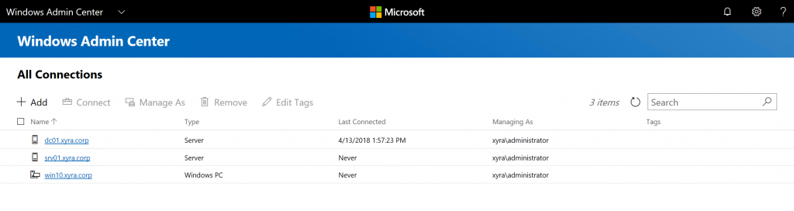
…IS THERE A GUI?
Notes:
Opcional para registrar todas las ejecuciones de forma centralizada
You can configure the PowerShell Module Logging policy using Group Policy

Slide 14
MORE INFO?
http://aka.ms/JEAdocs

Slide 15


DEMO

Slide 16
Thanks!
Any questions?
You can find me at:
@vmsilvamolina / blog.victorsilva.com.uy

